Slide 1
Entity Authentication
Dr. B C Dhara
Department of Information Technology
Jadavpur University

Slide 2
Objectives
Distinguish between message authentication and entity authentication
Discuss some methods of entity authentication using a password
Introduce some challenge-response protocols for entity authentication
Introduce some zero-knowledge protocols for entity authentication
Discuss biometrics and distinguish between physiological and behavioral techniques
B C Dhara, Dept. of IT, JU

Slide 3
Introduction
Entity authentication is a technique designed to let one party prove the identity of another party
An entity can be a person, a process, a client, or a server
The entity whose identity needs to be proved is called the claimant
The party that tries to prove the identity of the claimant is called the verifier
B C Dhara, Dept. of IT, JU

Slide 4
Message authentication Vs. Entity authentication
Message authentication might not happen in real time; entity authentication does
Message authentication simply authenticates one message; the process needs to be repeated for each new message; Entity authentication authenticates the claimant for the entire duration of a session
B C Dhara, Dept. of IT, JU

Slide 5
Entity authentication
Entity authentication can be done with one of witnesses:
  Something known
    Known by claimant, can be checked by verifier
      Password, PIN, private key etc.
  Something possessed
    A passport, driving license etc
  Something inherent
    Biometrics, …
B C Dhara, Dept. of IT, JU

Slide 6
Password base authentication
The simplest and oldest method of entity authentication is the password-based authentication, where the password is something that the claimant knows
  Fixed Password
  One-Time Password
B C Dhara, Dept. of IT, JU

Slide 7
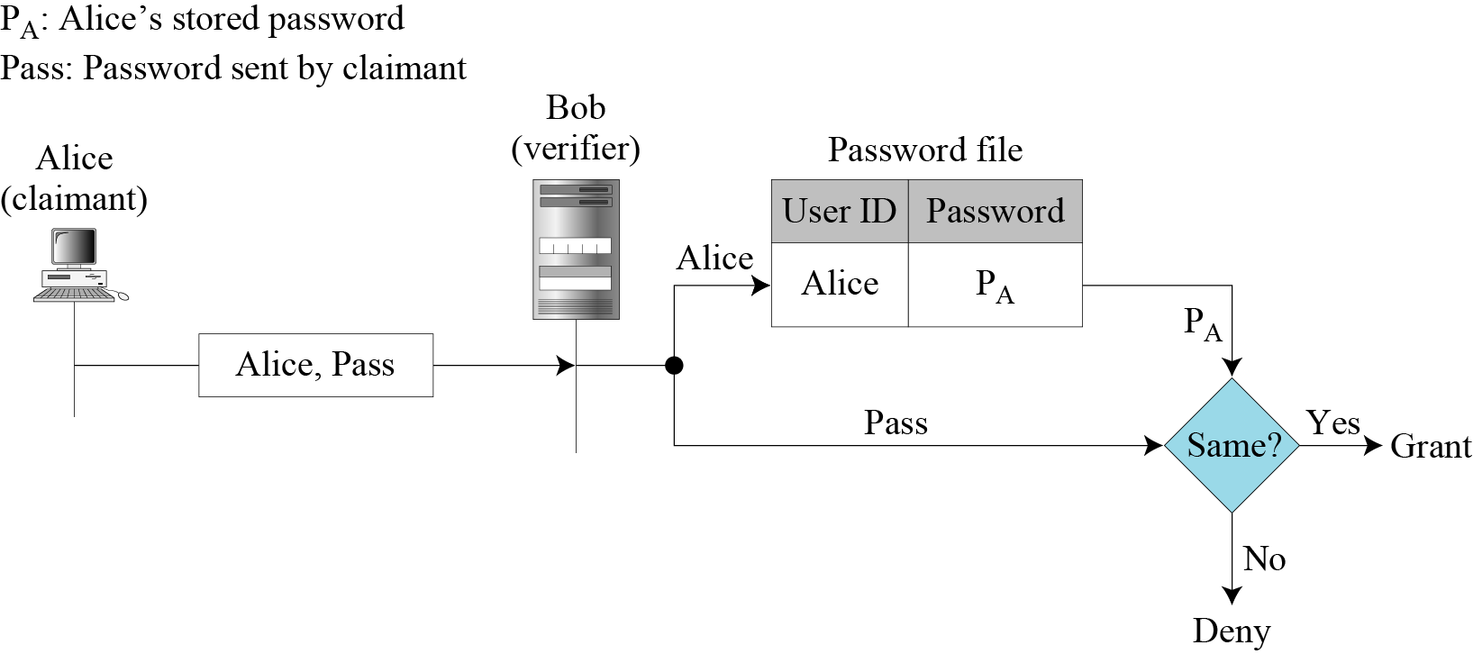
Fixed password
Same password is used again and again for every access
First Approach:
User ID and password
B C Dhara, Dept. of IT, JU

Slide 8
Attacks on first approach
Eavesdropping
Stealing a Password
Accessing Password file
Guessing a Password
B C Dhara, Dept. of IT, JU

Slide 9
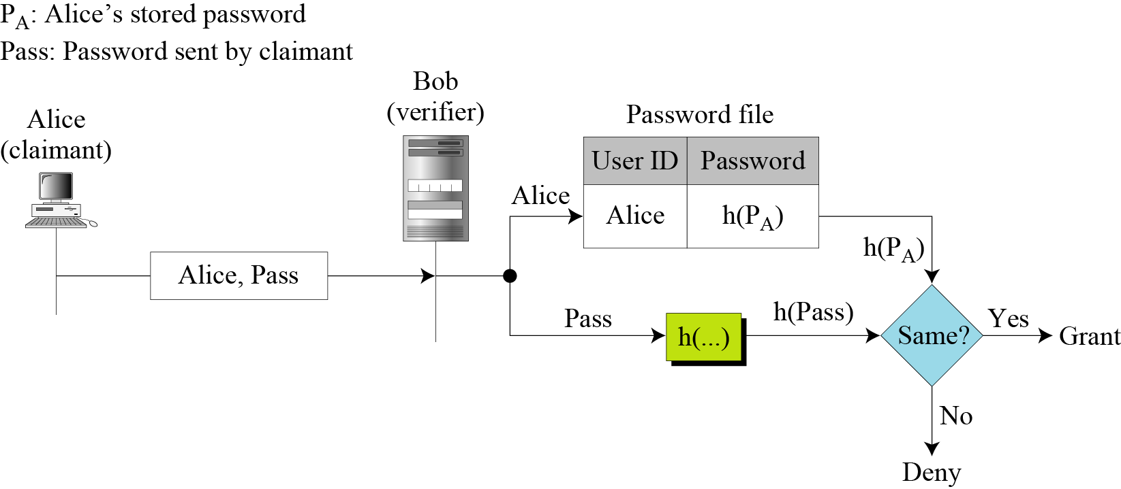
Second approach: hashing the password
Hashing the password
If Password length is limited, then all possible cases can be considered
B C Dhara, Dept. of IT, JU

Slide 10
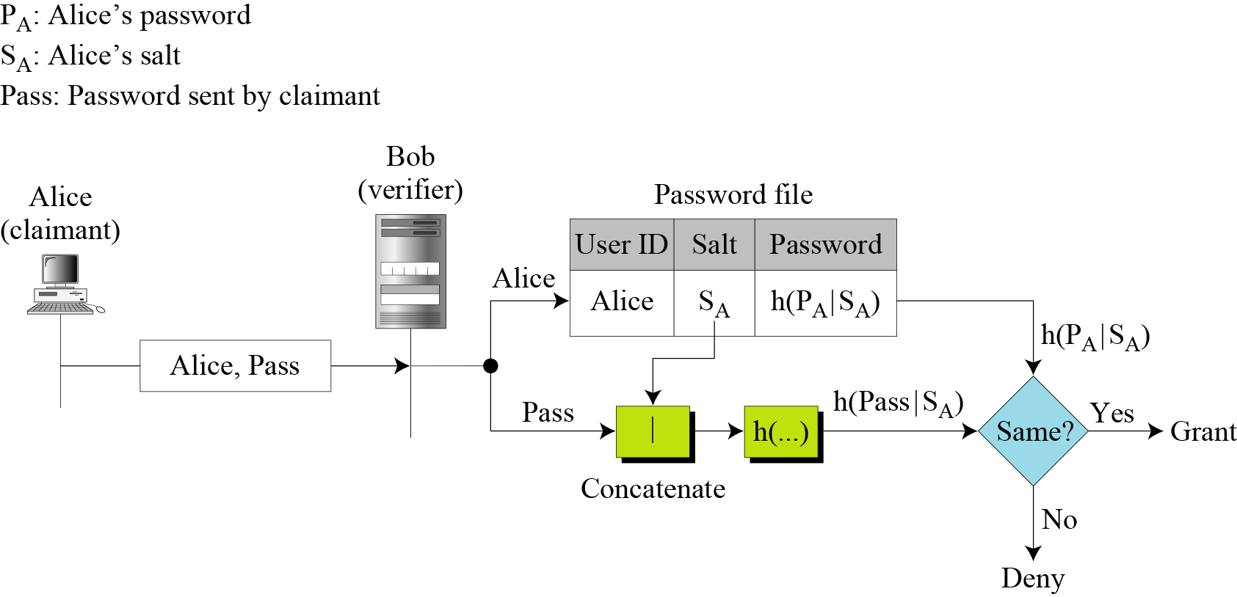

Third Approach: Salting the Password
Concept is same as previous one. Indirectly increases the size of the password and hence dictionary attack will be difficult
B C Dhara, Dept. of IT, JU

Slide 11
Fourth approach
Two identification techniques are combined
  A good example of this type of authentication is the use of an ATM card with a PIN
  Card belongs to “something possessed” and PIN “something known”
B C Dhara, Dept. of IT, JU

Slide 12
One time password (OTP)
First Approach
  In this approach, the user and the system agree upon a list of passwords
    System and user has to keep the list of passwords
    If password not used in sequential order, a long search
    eavesdropping and reuse are useless
Second approach
  In the second approach, the user and the system agree to sequentially update the password
    P_{i+1} created at the time i-th login and encrypted by P_{i}
    If first password can guess, then all subsequent will be available
B C Dhara, Dept. of IT, JU

Slide 13
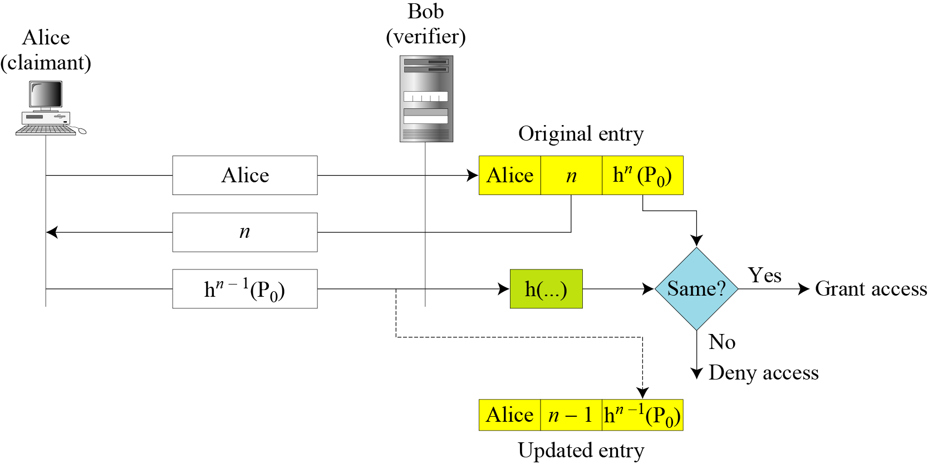
OTP
Third approach
  In the third approach, the user and the system create a sequentially updated password using a hash function
When n becomes ‘0’, the user can no longer access the system
B C Dhara, Dept. of IT, JU

Slide 14
CHALLENGE-RESPONSE PTOCOLS
In password based scheme, the claimant proves the identity by demonstrating that she knows a secret
In challenge-response authentication,
  The claimant proves that she knows a secret without sending it
  The claimant does not need to send the secret to the verifier, either verifer has it or finds it
B C Dhara, Dept. of IT, JU

Slide 15
CHALLENGE-RESPONSE PTOCOLS
First, claimant takes the initiative for the communication
Then, verifier send a time-varying value (or, time stamp), which is called challenge, send to claimant
The claimant applies a function to the challenge and the result, called as response, sends to the verifier
B C Dhara, Dept. of IT, JU

Slide 16
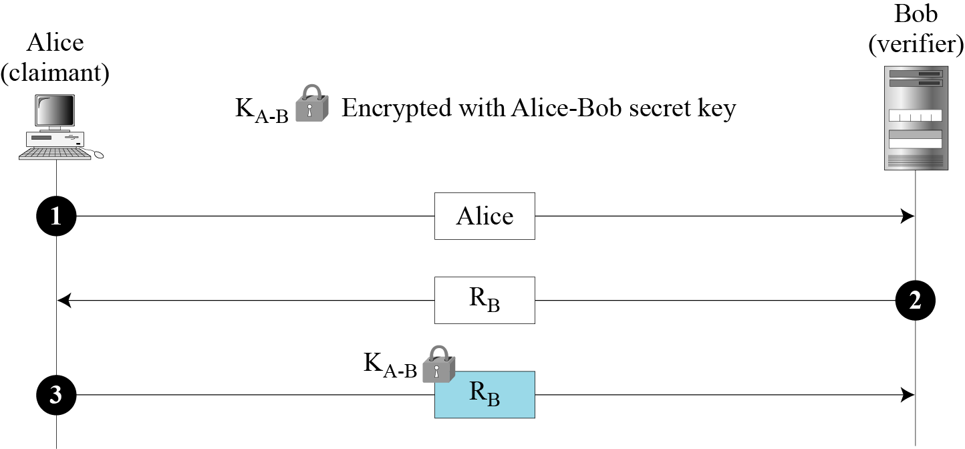
CHALLENGE-RESPONSE PTOCOLS: Using a Symmetric-Key Cipher
First approach:
Wants to be challenged
Nonce, a time varying value every time it created, it is different
Unidirectional authentication
B C Dhara, Dept. of IT, JU

Slide 17
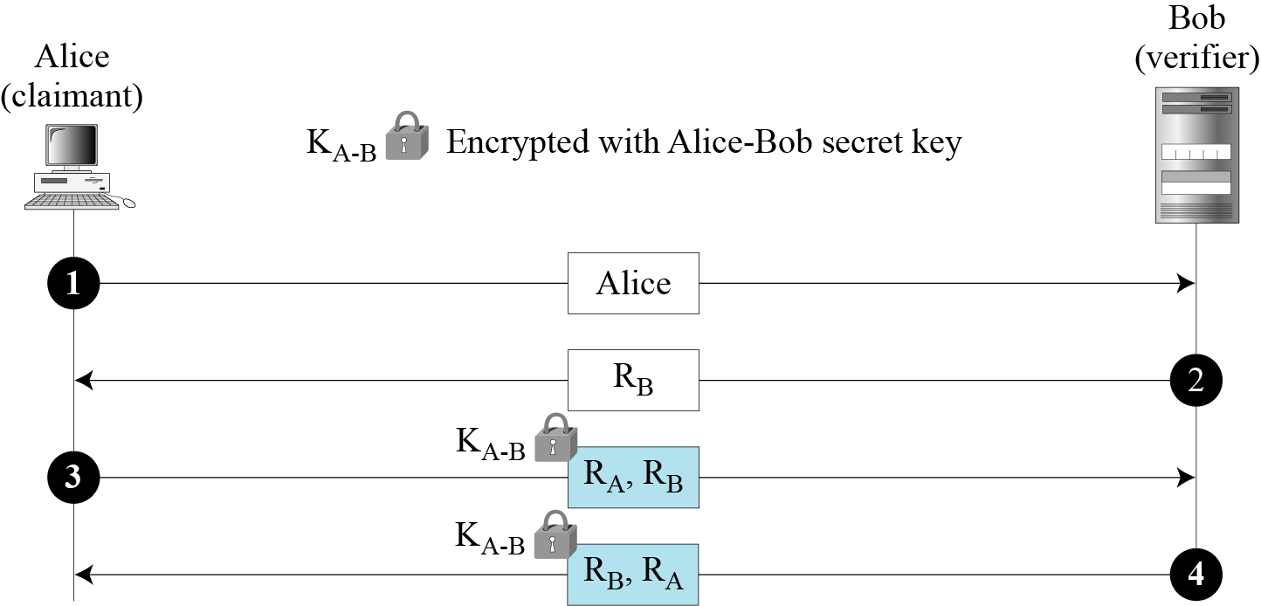
CHALLENGE-RESPONSE PTOCOLS: Using a Symmetric-Key Cipher (contd…)
Bidirectional authentication
B C Dhara, Dept. of IT, JU

Slide 18
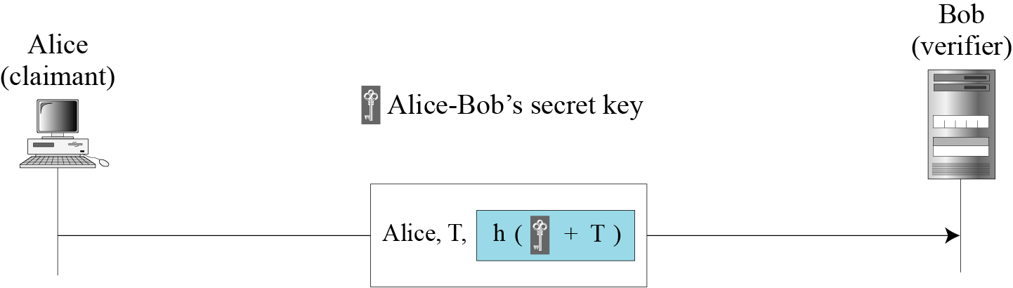
Using Keyed-Hash Functions
Instead of using encryption/decryption for entity authentication, we can also use a keyed-hash function (MAC).
Advantage: this method preserves the integrity of challenge and response messages
B C Dhara, Dept. of IT, JU

Slide 19
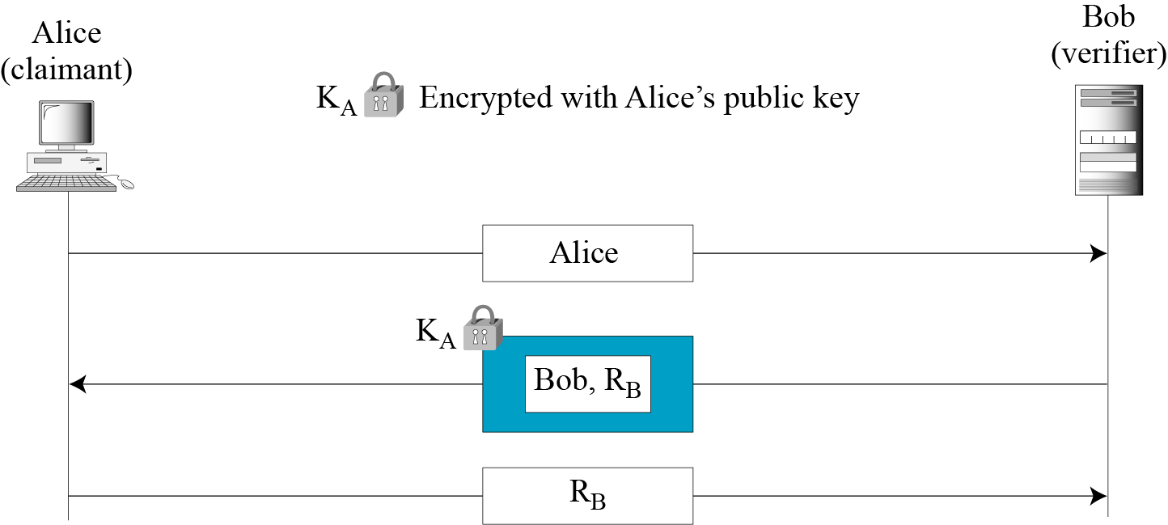
Using an Asymmetric-Key Cipher
Unidirectional, asymmetric-key authentication
B C Dhara, Dept. of IT, JU

Slide 20
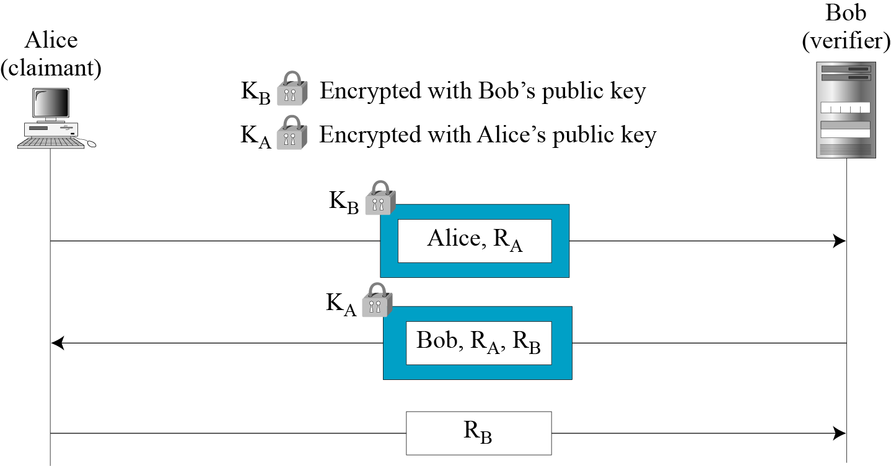
Using an Asymmetric-Key Cipher (contd…)
Bidirectional, asymmetric-key
B C Dhara, Dept. of IT, JU

Slide 21
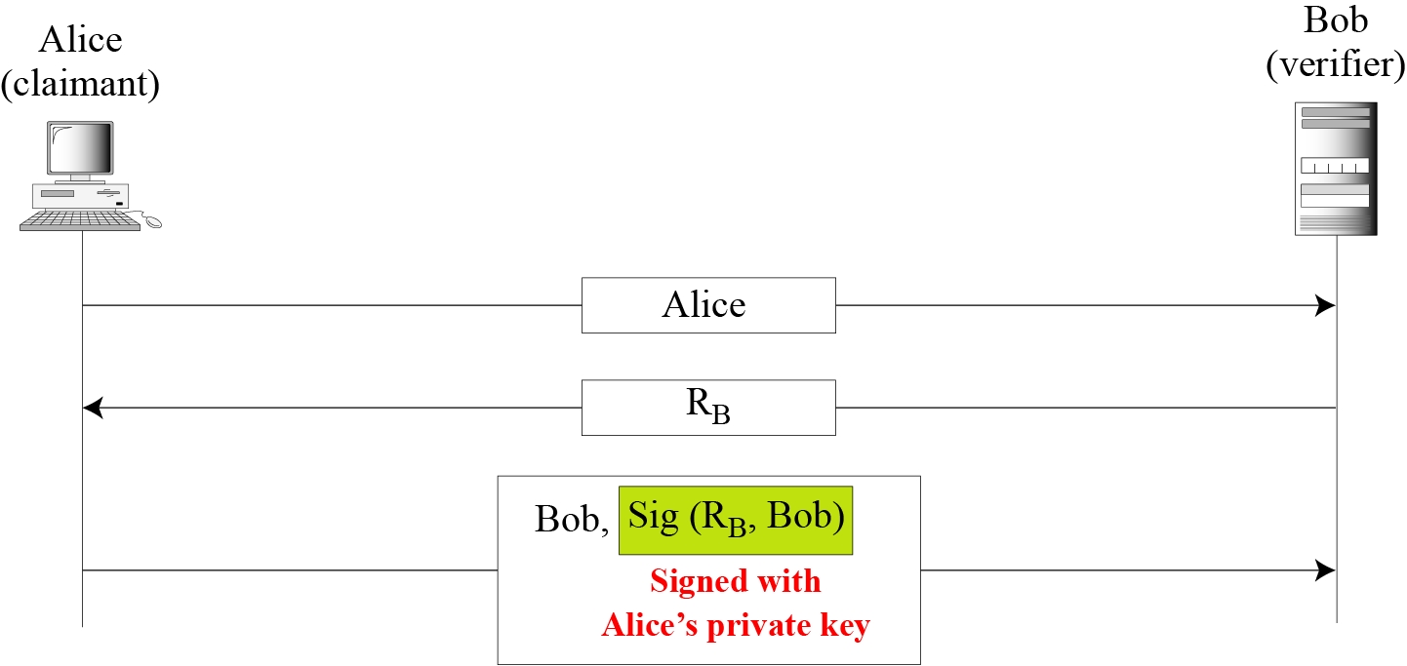
Using Digital Signature
Digital signature, unidirectional
B C Dhara, Dept. of IT, JU

Slide 22
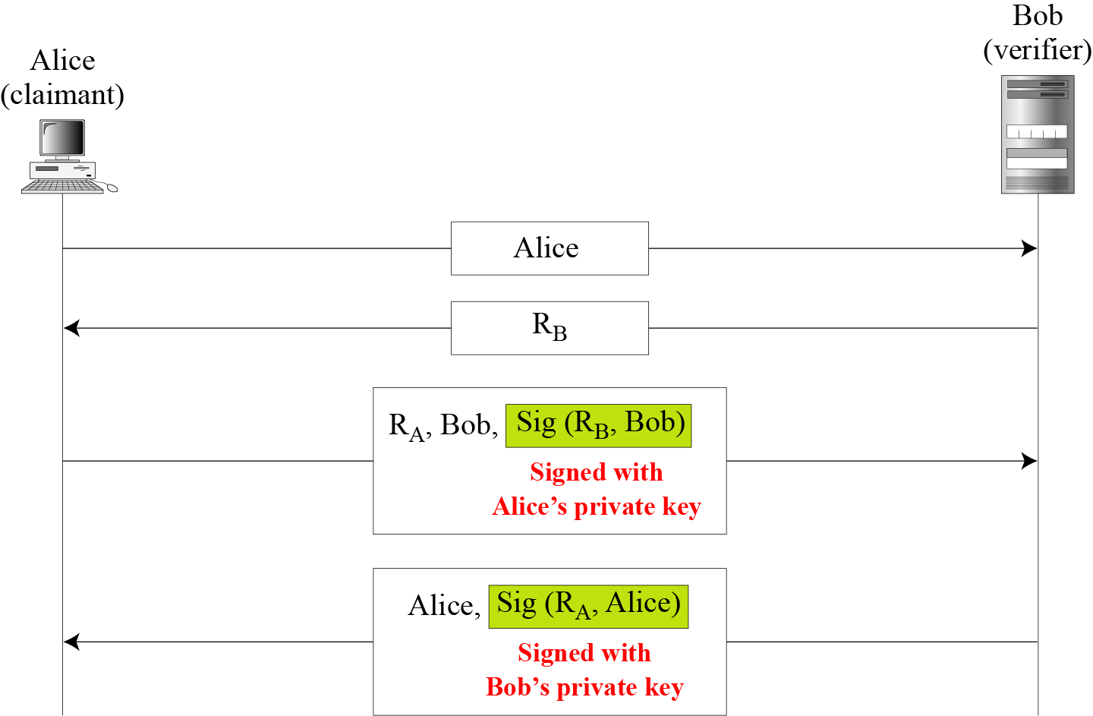
Using Digital Signature (contd…)
Digital signature, bidirectional authentication
B C Dhara, Dept. of IT, JU

Slide 23
Biometrics
Biometrics is the measurement of physiological or behavioral features that identify a person (authentication by something inherent). Biometrics measures features that cannot be guessed, stolen, or shared.
Several components are needed for biometrics, including capturing devices, processors, and storage devices..
Before using any biometric techniques for authentication, the corresponding feature of each person in the community should be available in the database. This is referred to as enrollment.
B C Dhara, Dept. of IT, JU

Slide 24
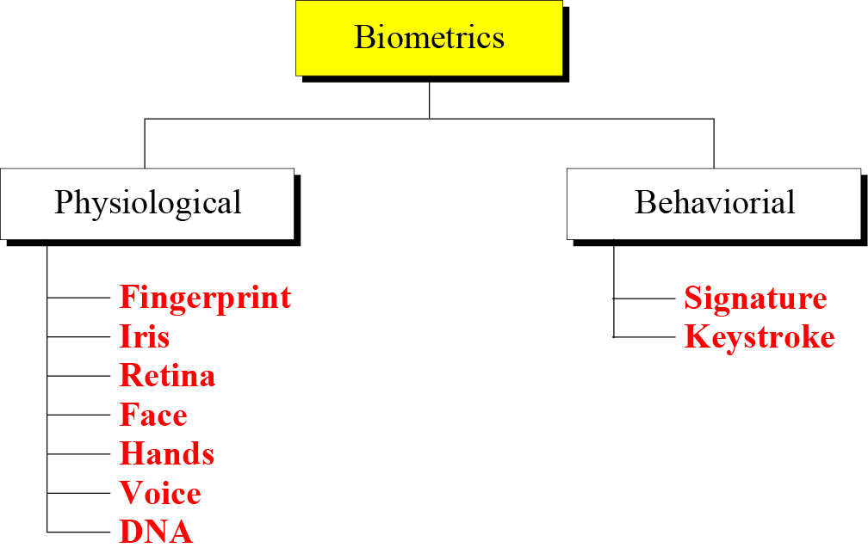
Types of Biometrics
B C Dhara, Dept. of IT, JU

Slide 25
Authentication
Verification: 1-2-1 matching
Identification: 1-2-m matching
B C Dhara, Dept. of IT, JU

Slide 26
Accuracy
False Rejection Rate (FRR): System should recognize the person, but fails to recognize
False Acceptance Rate (FAR): should not recognize, but system recognize the person
B C Dhara, Dept. of IT, JU

Slide 27
Applications of biometric
Several applications of biometrics are already in use
In commercial environments, these include access to facilities, access to information systems, transaction at point-of sales, and employee timekeeping
In the law enforcement system, they include investigations (using fingerprints or DNA) and forensic analysis
Border control and immigration control also use some biometric techniques
B C Dhara, Dept. of IT, JU

